Slide 1

WIKI Improvements
Prepared By:
Joe Kirkwood
Chad Runion
Connie Giordano

Slide 2
Goals of the Wiki Enhancements
Support SDO objectives for call resolution and average handle times by making product, customer, and representative information accessible and navigable.
Encourage collaboration and intra-team communication by building content creation and feedback processes.
Improve agent usage of the Wiki/knowledge base through graphical and other usability enhancements
Develop and apply a tool-independent structure for the knowledge base

Slide 3
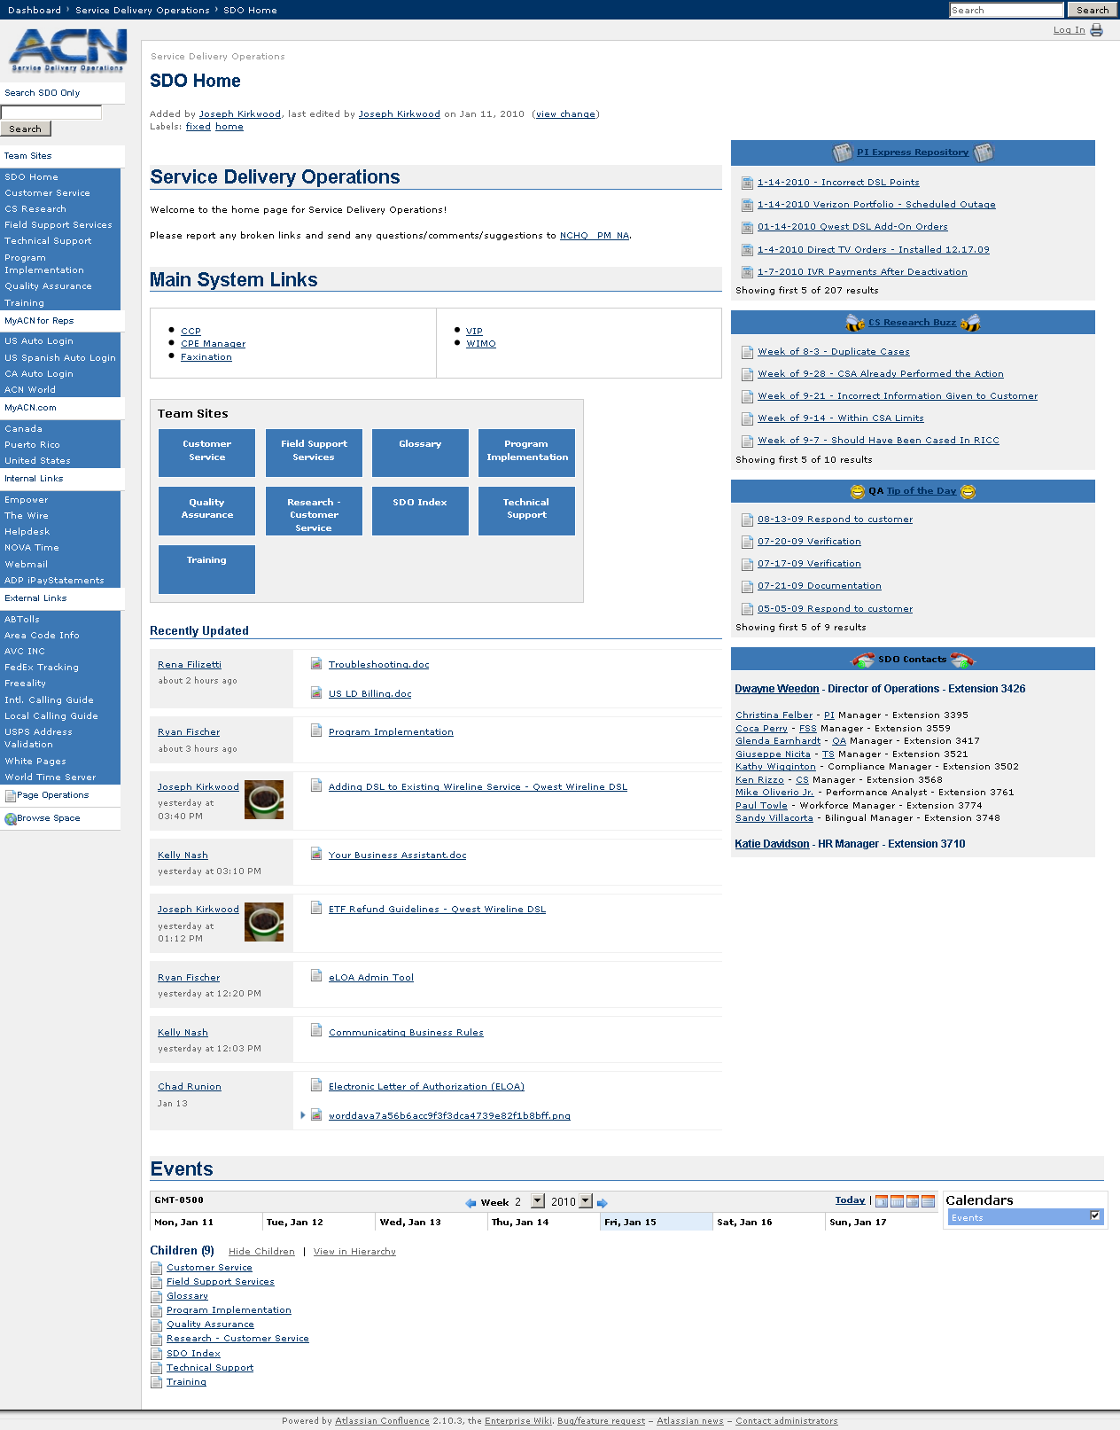
From Good . . .

Slide 4
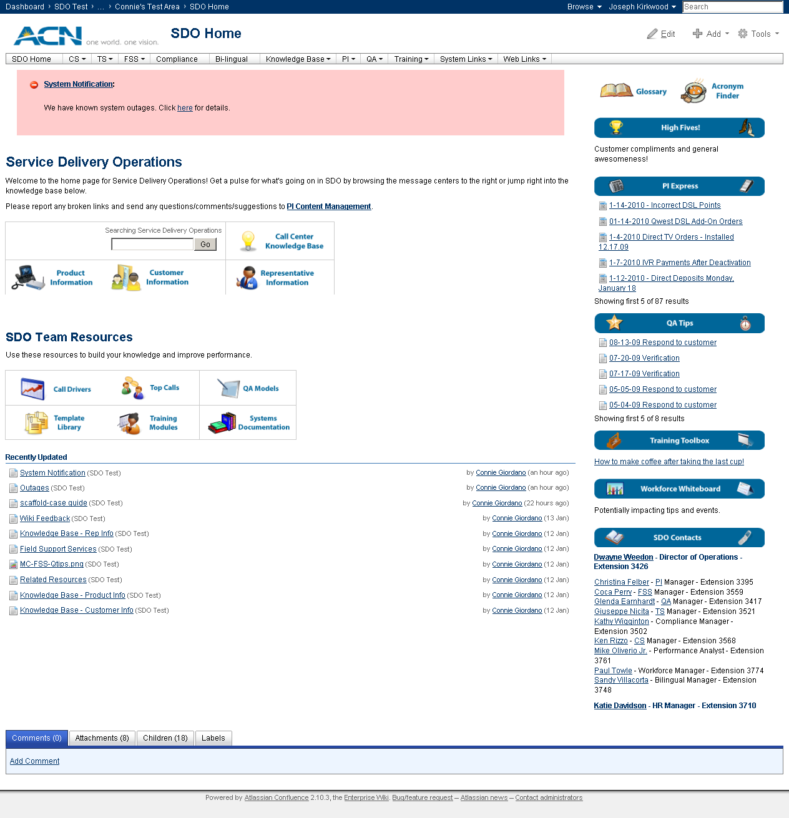
. . . to Great!

Slide 5
What we did
Menu Bar
Message Centers
Related Resources
System Notifications
New Graphics/Icons
Data Chunking
Toggles/Tabs
Taxonomy/Labels

Slide 6
Why we did it
Improved navigation and usability
Site aesthetics
Targeted Information
Repeatable Processes
Improved Accuracy
Single Sourcing

Slide 7
Menu Bar
Benefits
  Clears screen real estate to provide more information without scrolling
  Provides quick access to all main landing pages and useful links
  Updates automatically allowing easier maintenance

Slide 8
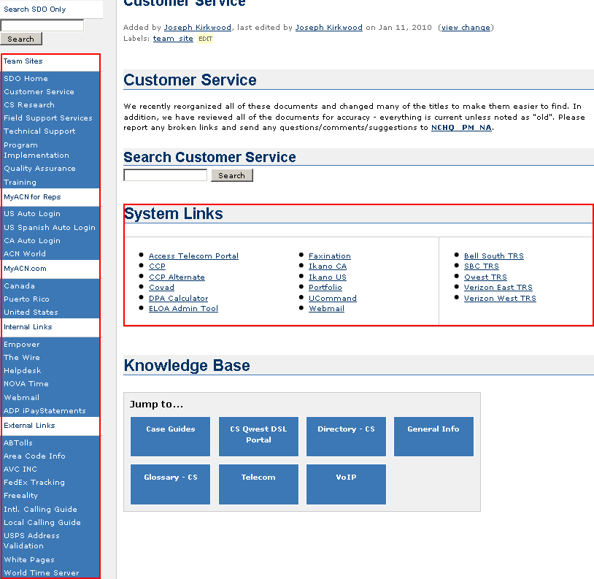

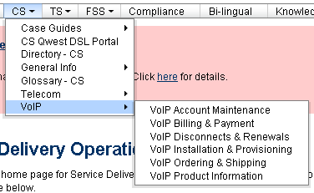
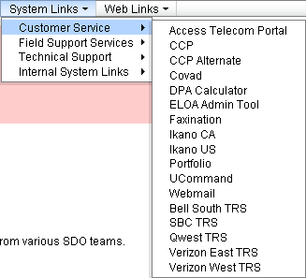
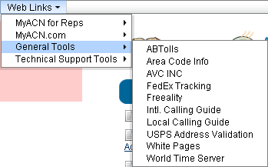

Slide 9
System Notifications
Benefits
  Constant visibility to upcoming/potential and ongoing system issues
  Reductions in email/redundant messages
  More visibility to actual issues/ETRs
  Historical records of systemic issues

Slide 10
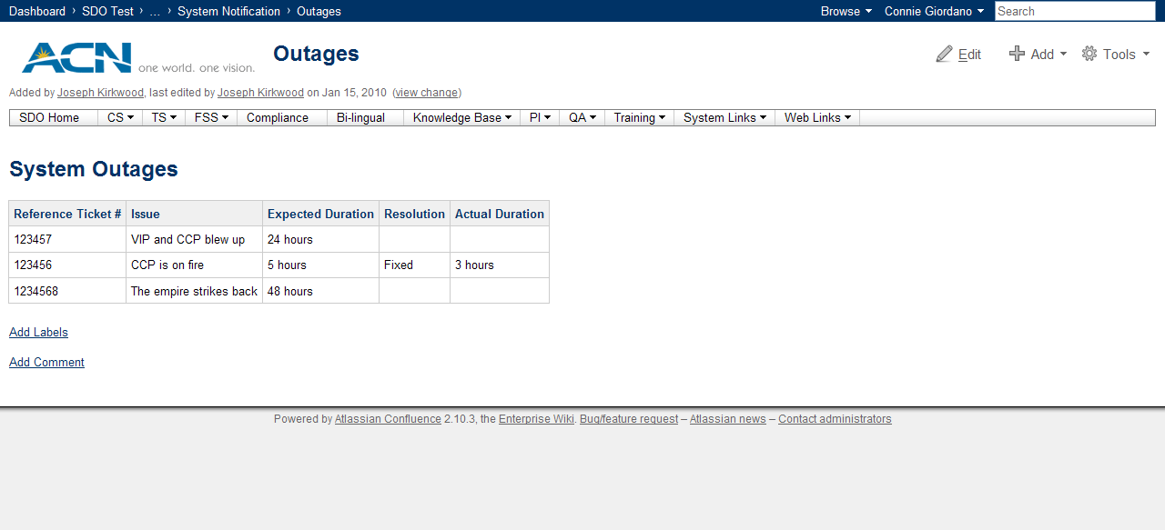
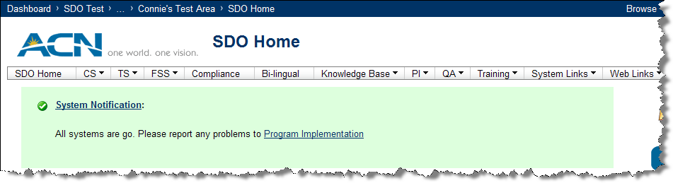
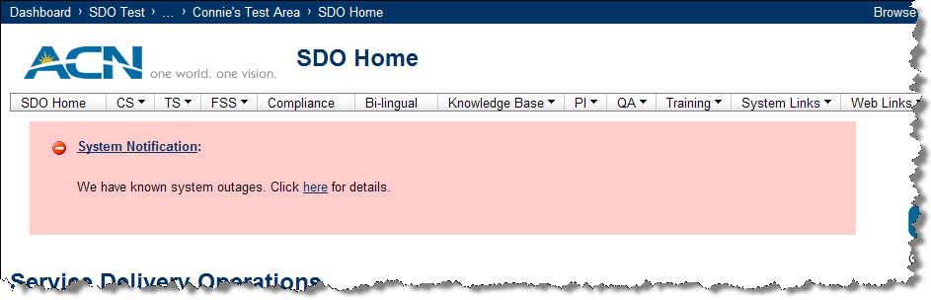

Slide 11
Toggles/Tabs
Benefits
  Allows for more information on a single page
  Information on demand – multiple documents
  Pre-loaded – expandable upon clicking
  Workflow-based documentation
    Allows documents to show based on QA model and customer issues

Slide 12
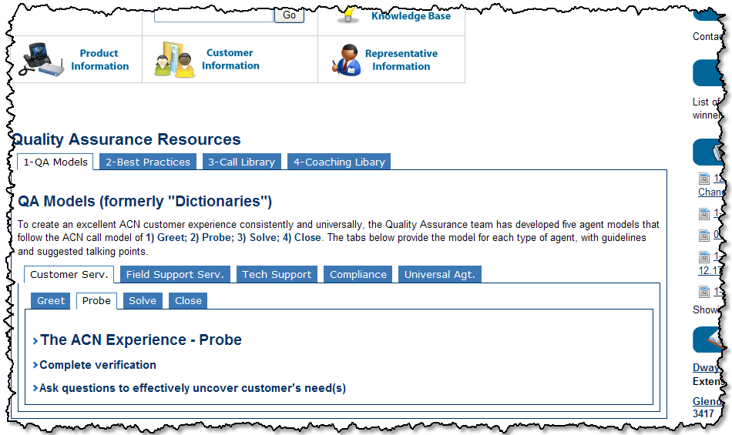
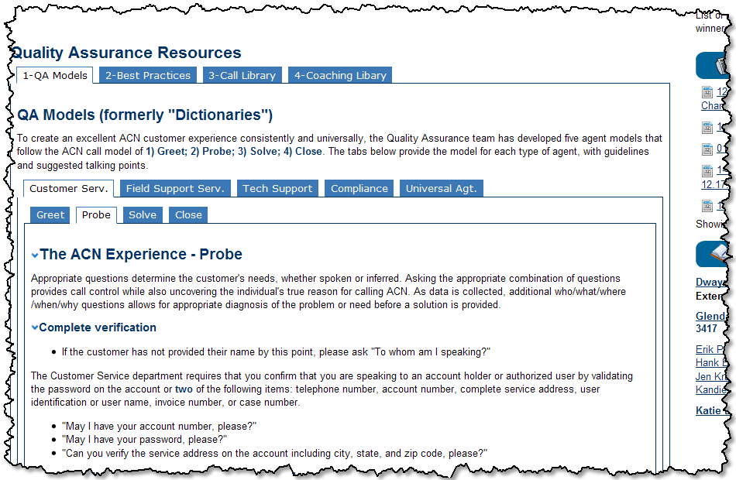

Slide 13
New Theme
Benefits
  More page real estate
  Cleaner look – fewer dark colors
  Allows all pertinent resources to stand out better on the page

Slide 14
Message Centers
Benefits
  Updated look and feel – each one is easier to distinguish with cleaner look and new title graphics
  Easier to set up templates to help drive consistency
  Increased visibility to best practices – call center wide
  Reduced email usage

Slide 15
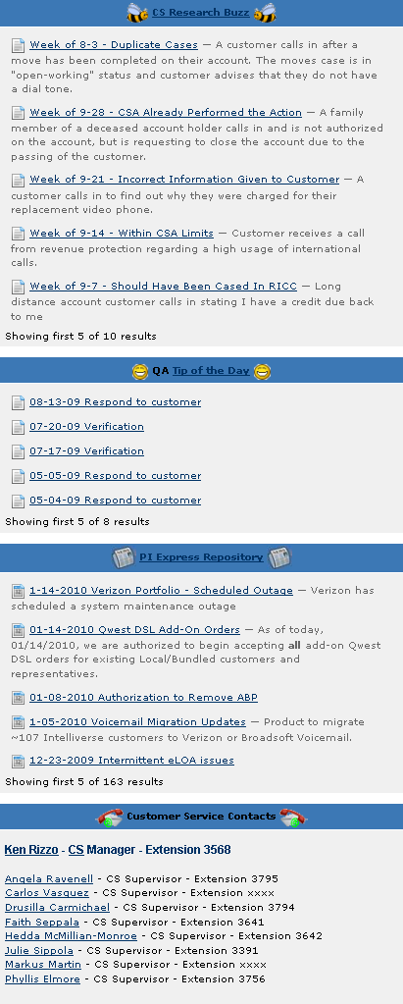
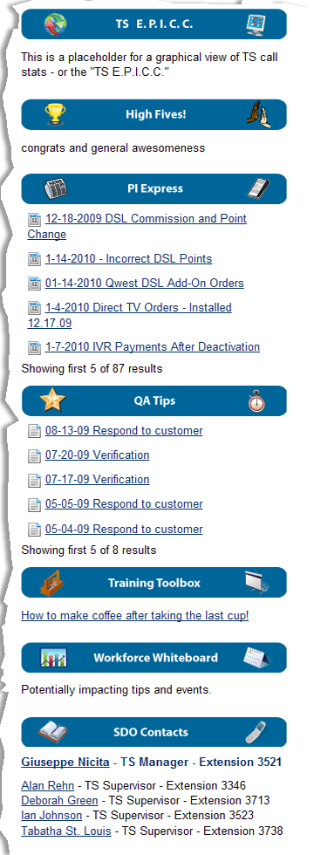
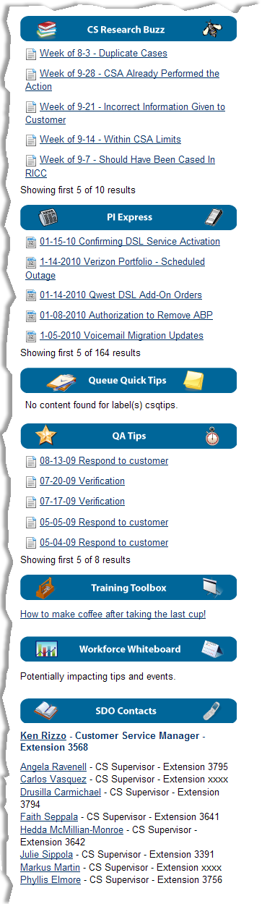
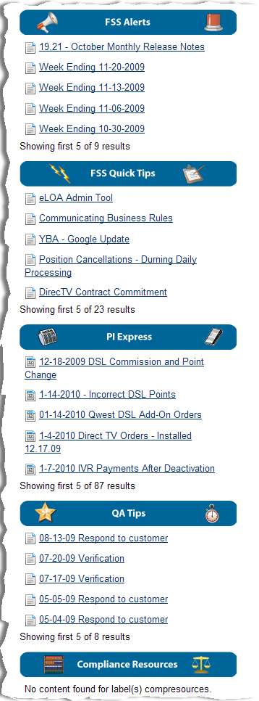

Slide 16
New User Rights (Coming Soon)
Benefits
  Supervisors/Managers/QA/Training now have editing access
  Allows for more timely feedback and quick edits as issues surface
  Teams can now be responsible for their own message center content
Delivery
  Manager access is available now, training on procedures dependent upon SharePoint deployment

Slide 17
Related Resources (Coming Soon)
Benefits
  Terms & Conditions/Business Rules/Policies & Procedures
    Quick access – broken into much smaller, on-demand chunks to allow easier comprehension
  Chunks can be fed into other documentation as reference points when needed
  Drives better maintenance, consistency and process improvements
  Streamlines existing documentation
  Acronym Finder and Glossary – to help drive understanding and consistency
    Quick access from all landing pages
Delivery
  T&C, Polices & Procedures completed, Business Rules by 2/28, Acronym Finder and Glossary by 3/15

Slide 18
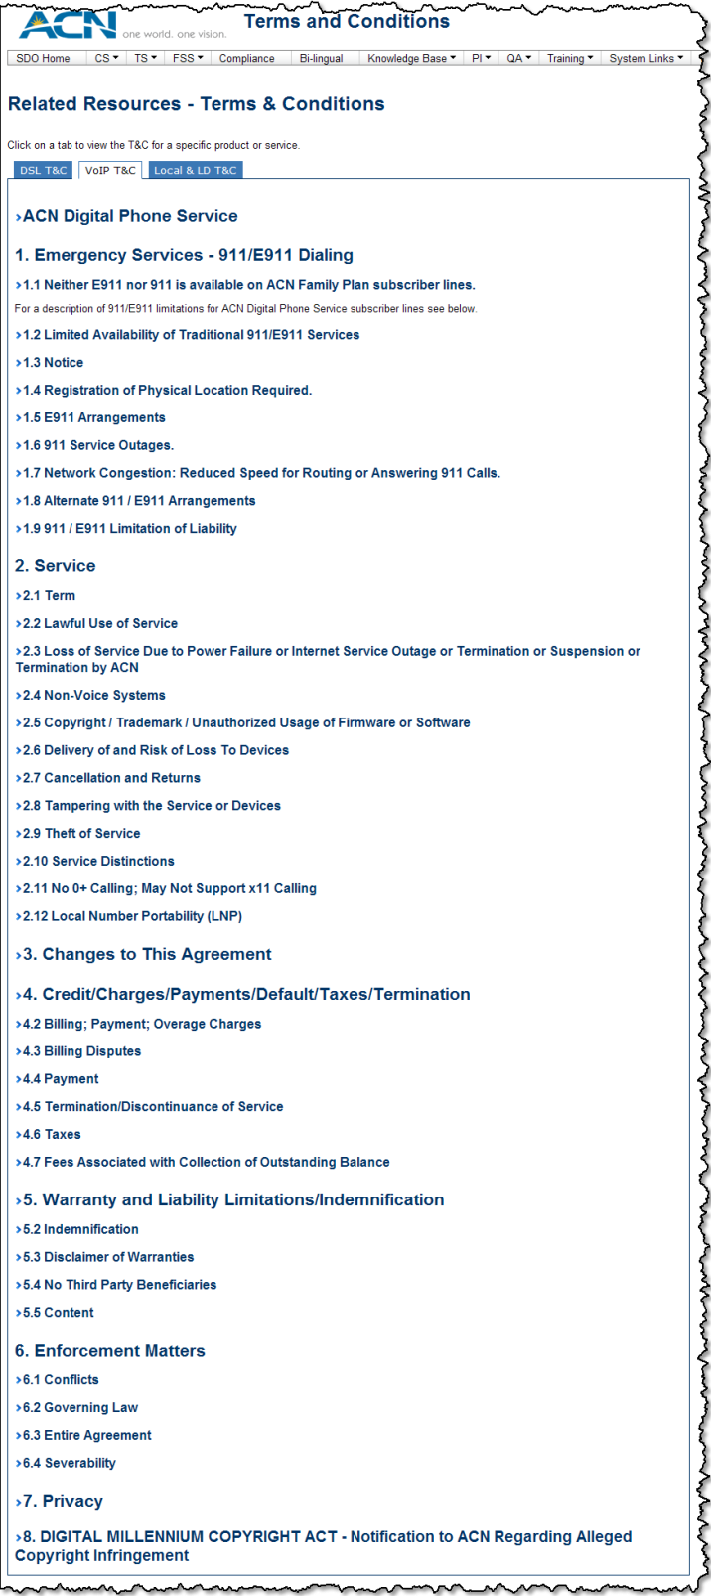
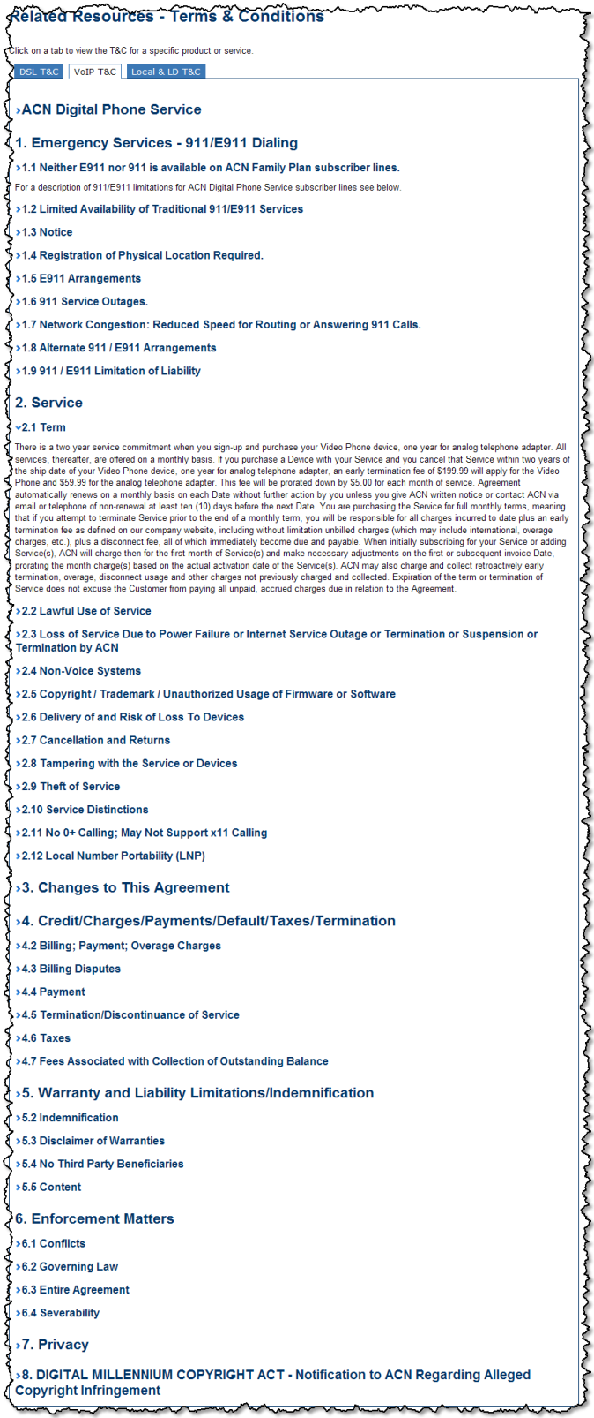

Slide 19
Taxonomy/Labeling/Chunking (Coming Soon)
Benefits
  Taxonomy provides a roadmap for labeling and chunking documents
  Labeling provides a non-linear organizational structure that is intuitive and organic
  Chunking (single sourcing) documents provides automation during maintenance -
    Improves accuracy and consistency while reducing maintenance time
Delivery
  High level draft completed, next iteration by 2/28

Slide 20
Templates
Benefits
  Dynamic templates to help drive consistency and repeatable processes
  Allows non-technical users to easily add content
  Helps to capture metadata for easy organization
  Drive process improvements as gaps will become more visible
  Asks the appropriate questions prior to document creation to ensure the request is valid and/or that the information is relevant

Slide 21
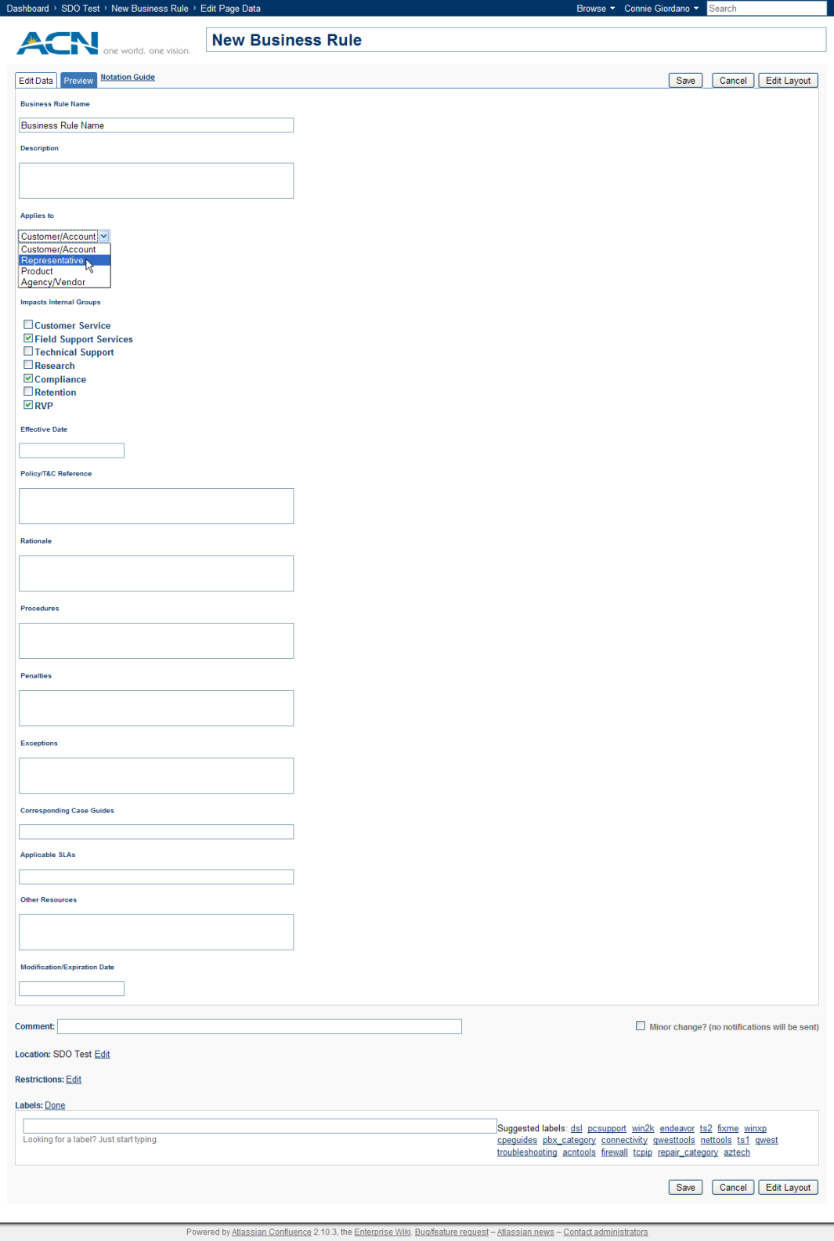
Business Rule Template

